Slide 1
CHAPTER 8:
Sampling Distributions
to accompany
Introduction to Business Statistics
seventh edition, by Ronald M. Weiers
Presentation by Priscilla Chaffe-Stengel
Donald N. Stengel
© 2011 Cengage Learning.
All Rights Reserved. May not be scanned, copied, or duplicated, or posted to a publicly accessible website, in whole or in part.

Slide 2
Chapter 8 - Learning Objectives
Determine the sampling distributions of:
  Means.
  Proportions.
Explain the Central Limit Theorem.
Determine the effect on the sampling distribution when the samples are relatively large compared to the population from which they are drawn.
© 2011 Cengage Learning.
All Rights Reserved. May not be scanned, copied, or duplicated, or posted to a publicly accessible website, in whole or in part.

Slide 3
Sampling Distribution of the Mean
When the population is normally distributed
  Shape: Regardless of sample size, the distribution of sample means will be normally distributed.
  Center: The mean of the distribution of sample means is the mean of the population. Sample size does not affect the center of the distribution.
  Spread: The standard deviation of the distribution of sample means, or the standard error, is
σ
σ
=
.
x
n
© 2011 Cengage Learning.
All Rights Reserved. May not be scanned, copied, or duplicated, or posted to a publicly accessible website, in whole or in part.

Slide 4
Standardizing a Sample Mean on a Normal Curve
The standardized z-score is how far above or below the sample mean is compared to the population mean in units of standard error.
  “How far above or below” = sample mean minus µ
  “In units of standard error” = divide by
Standardized sample mean
σ
n
sample
mean
−
μ
x
–
μ
z
=
=
standard
error
σ
n
© 2011 Cengage Learning.
All Rights Reserved. May not be scanned, copied, or duplicated, or posted to a publicly accessible website, in whole or in part.

Slide 5
Central Limit Theorem
According to the Central Limit Theorem (CLT), the larger the sample size, the more normal the distribution of sample means becomes. The CLT is central to the concept of statistical inference because it permits us to draw conclusions about the population based strictly on sample data without having knowledge about the distribution of the underlying population.
© 2011 Cengage Learning.
All Rights Reserved. May not be scanned, copied, or duplicated, or posted to a publicly accessible website, in whole or in part.

Slide 6
Sampling Distribution of the Mean
When the population is not normally distributed
  Shape: When the sample size taken from such a population is sufficiently large, the distribution of its sample means will be approximately normally distributed regardless of the shape of the underlying population those samples are taken from. According to the Central Limit Theorem, the larger the sample size, the more normal the distribution of sample means becomes.
© 2011 Cengage Learning.
All Rights Reserved. May not be scanned, copied, or duplicated, or posted to a publicly accessible website, in whole or in part.

Slide 7
Sampling Distribution of the Mean
When the population is not normally distributed
  Center: The mean of the distribution of sample means is the mean of the population, µ. Sample size does not affect the center of the distribution.
  Spread: The standard deviation of the distribution of sample means, or the standard error, is
σ
σ
=
.
x
n
© 2011 Cengage Learning.
All Rights Reserved. May not be scanned, copied, or duplicated, or posted to a publicly accessible website, in whole or in part.

Slide 8

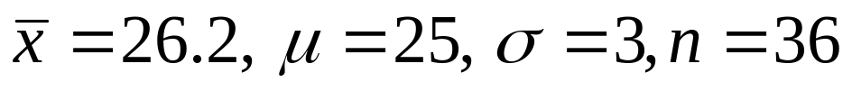
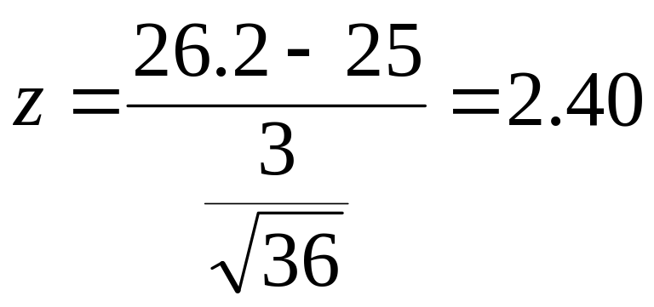
Example: Standardizing a Mean
Problem 8.47: When a production machine is properly calibrated, it requires an average of 25 seconds per unit produced, with a standard deviation of 3 seconds. For a simple random sample of n = 36 units, the sample mean is found to be 26.2 seconds per unit.
  What z-score corresponds to the sample mean of ?
© 2011 Cengage Learning.
All Rights Reserved. May not be scanned, copied, or duplicated, or posted to a publicly accessible website, in whole or in part.

Slide 9

Example: Standardizing a Mean
Problem 8.47: When a production machine is properly calibrated, it requires an average of 25 seconds per unit produced, with a standard deviation of 3 seconds. For a simple random sample of n = 36 units, the sample mean is found to be 26.2 seconds per unit.
  When the machine is properly calibrated, what is the probability that the mean for a simple random sample of this size will be at least 26.2 seconds?
  Standardized sample mean:
© 2011 Cengage Learning.
All Rights Reserved. May not be scanned, copied, or duplicated, or posted to a publicly accessible website, in whole or in part.

Slide 10
Sampling Distribution of the Proportion
When the sample statistic is generated by a count not a measurement, the proportion of successes in a sample of n trials is p, where
  Shape: Whenever both n π and n(1 – π) are greater than or equal to 5, the distribution of sample proportions will be approximately normally distributed.
© 2011 Cengage Learning.
All Rights Reserved. May not be scanned, copied, or duplicated, or posted to a publicly accessible website, in whole or in part.

Slide 11
Sampling Distribution of the Proportion
When the sample proportion of successes in a sample of n trials is p,
  Center: The center of the distribution of sample proportions is the center of the population, π.
  Spread: The standard deviation of the distribution of sample proportions, or the standard error, is
π
⋅
π
σ
=
(
1
–
)
.
p
n
© 2011 Cengage Learning.
All Rights Reserved. May not be scanned, copied, or duplicated, or posted to a publicly accessible website, in whole or in part.

Slide 12
Standardizing a Sample Proportion on a Normal Curve
The standardized z-score is how far above or below the sample proportion is compared to the population proportion in units of standard error.
  “How far above or below” = sample p – π
  “In units of standard error” = divide by
Standardized sample proportion
σ
=
π
⋅
(
1
–
π
)
p
n
sample
proportion
−
π
p
–
π
z
=
=
π
⋅
π
standard
error
(
1
–
)
n
© 2011 Cengage Learning.
All Rights Reserved. May not be scanned, copied, or duplicated, or posted to a publicly accessible website, in whole or in part.

Slide 13
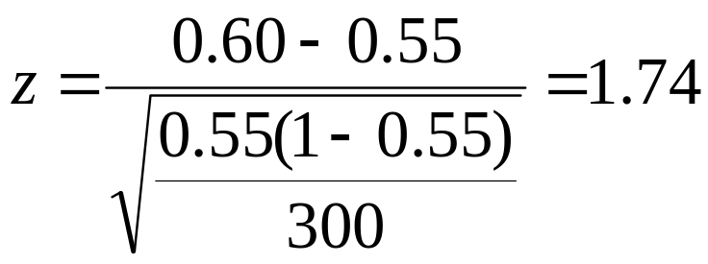
Example: Standardizing a Proportion
Problem 8.42: The campaign manager for a political candidate claims that 55% of registered voters favor the candidate over her strongest opponent. Assuming that this claim is true, what is the probability that in a simple random sample of 300 voters, at least 60% would favor the candidate over her strongest opponent?
  π = 0.55, p = 0.60, n = 300
  Standardized sample proportion:
© 2011 Cengage Learning.
All Rights Reserved. May not be scanned, copied, or duplicated, or posted to a publicly accessible website, in whole or in part.

Slide 14
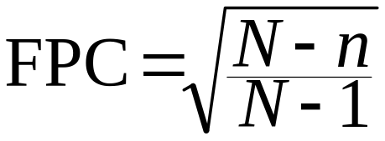
When the Population is Finite
Finite Population Correction (FPC) Factor:
  Rule of Thumb: Use FPC when n > 5%•N.
  Apply to: Standard errors of mean and proportion.
© 2011 Cengage Learning.
All Rights Reserved. May not be scanned, copied, or duplicated, or posted to a publicly accessible website, in whole or in part.

